Slide 1
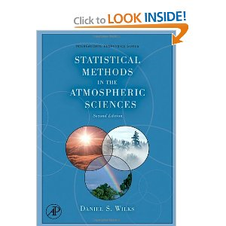


ATMOSPHERIC SCIENCES 5040/6040- Environmental Statistics
Instructors: John Horel, Court Strong
Grader: Chris Foster
Required Text: Matlab Recipes for Earth Sciences.
Available as eBook through library. The eBook can be read online or checked out for 24 hours
Recommended if interested in python: Python Programming
Recommended text for 6040: Statistical Methods in the Atmospheric Sciences

Slide 2
What you should be doing
Assignment 1- Survey- Due Tonight
Read Chapter 1 Notes
Read Chapter 1 in text
No class Wednesday
Spend time reading above
Complete Assignment 2 based on Chapter 1 notes and text
Due Sunday night midnight

Slide 3
Course Learning Objectives
State and use basic statistical metrics to analyze environmental information
Develop proficiency to program and use computer software to analyze environmental data sets
State and demonstrate the characteristics of effective research; organize, quality control, and find relationship(s) among data

Slide 4
Official Syllabus
In Canvas
Direct link to course: https://utah.instructure.com/courses/541131

Slide 5
When you have questions…
email: john.horel@utah.edu
Use the class slack channel
(will be discussed next week)
Office hours: by appointment
Send email, a message in slack or phone

Slide 6
5040/6040 Course Outline
Week 1. Jan. 7, 9. Basic concepts
Week 2. Jan. 14, 16. Exploratory Univariate Data Analysis
Week 3. Jan. 21. Holiday. No class. Jan. 23. Transforming Data
Week 4. Jan. 28, 30. Directional Data & Probability
Week 5. Feb 4, 6. Parametric Distributions
Week 6. Feb. 11, 13. Exploratory Multivariate Data Analysis. Correlations
Week 7 Feb. 18. Holiday. No class. Feb 20. Exploratory Multivariate Data Analysis. Compositing
Week 8. Feb. 25. First Half Wrap Up. Take Home Final-5040/Midterm-6040. Due March 6

Slide 7
6040 Course Outline
Weeks 9-10. Topics in regression (multiple and curvilinear regression)
Weeks 11-12. Harmonic analysis (spectral analysis and filtering)
Weeks 13-14. Data reduction (empirical orthogonal function analysis)

Slide 8
Format
Meet in 820 WBB on most** Mondays, MLIB 1110 on Wednesdays
You must read the assigned text and class notes prior to the corresponding lecture
During the first half semester, there will be an assignment due nearly every class day
Assignments completed late will receive at most partial credit
Take Home Exam due- March 6: (5040: final); (6040: midterm)
6040: Instead of a final exam, you will pursue a research question using statistical methods to analyze data

Slide 9
Class Policies and Grading
5040:
(1) final (33%)
(2) class assignments (66%)
6040:
(1) assignments (60%)
(2) mid-term exam (20%)
(3) research project (20%)

Slide 10
Programming Languages
Programs written in a specific language are just variations on ways to pass instructions to a computer
Each language has its own syntax (form) and semantics (meaning)
Syntax: Sequences of text including words, numbers, and punctuation using rules like written languages (grammar)
Semantics: The meaning given to the syntax - a sequence of words that makes sense to a computer

Slide 11
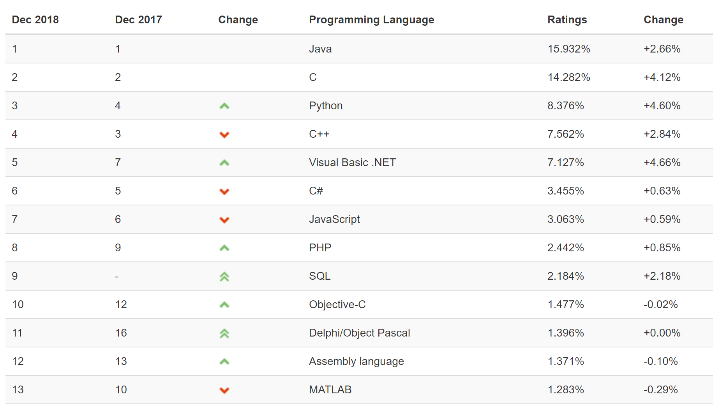
Popularity of programming languages https://www.tiobe.com/tiobe-index/

Slide 12

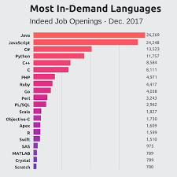
Matlab
Python
Proprietary
Inexpensive for educational uses, expensive otherwise
Flexible graphical user interface
Many toolboxes
Matrix oriented
Open source
Free, although enterprise releases for commercial applications
Notebooks are a convenient way to learn
Many modules
Object oriented

Slide 13
In this course:
Matlab
Python
All codes available in Matlab
What nearly everyone should use
Matlab text required
Nearly all codes available in python
Some may want to do some exercises using python
Intro text recommended
Everything in one github repository (notes, codes, data): https://github.com/johnhorel/atmos_5040_2019
Programming language reviews from ATMOS 5020 in repository
Notes independent of language
It may be possible to have additional lab time on Wednesdays after the official class period ends

Slide 14
Matlab
Python
We will be using Marriott Library classroom
you will need to do assignments using the library or other locations that have Matlab with statistics tool box installed
Not required to own a copy of Matlab but may be helpful. Costs $30
Review Matlab material in Canvas and github repository
Python installed on Marriott Library computers
We will use python notebooks at times to show how python handles statistical calculations
Instructions provided on how to install python locally, but not required
Not required to look at, but lots of python material in github repository

Slide 15
Problems with statistics?
Oriented towards confirming preconceived ideas?
Start with a technique and look for a data set to apply it to?
There’s always two sides to every issue?
What do you think? Other examples of poor statistics?

Slide 16
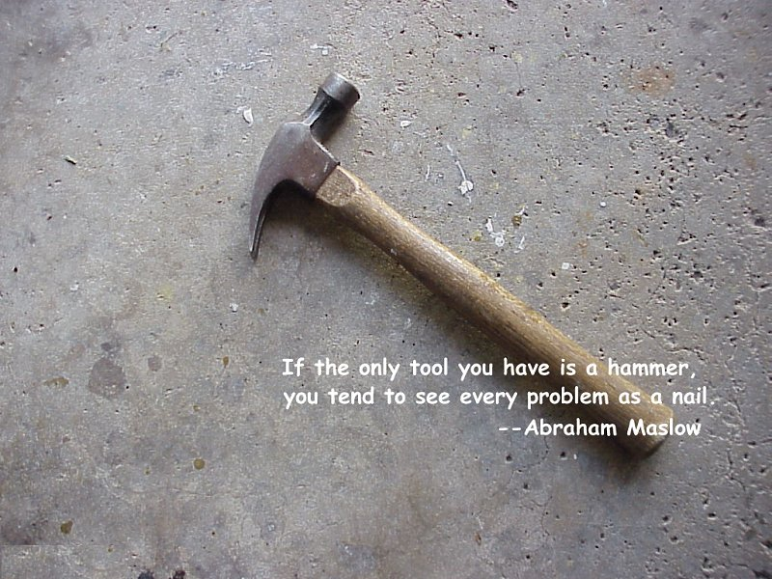

Slide 17
Questioning traditional statistical approaches
Nassim Nicholas Taleb
http://www.fooledbyrandomness.com/
Black Swan: extreme impact of rare and unpredictable events and human tendency to search for simplistic explanations for these events retrospectively
Antifragile: Some things benefit from shocks and thrive when exposed to volatility, randomness, disorder, stressors, and uncertainty

Slide 18
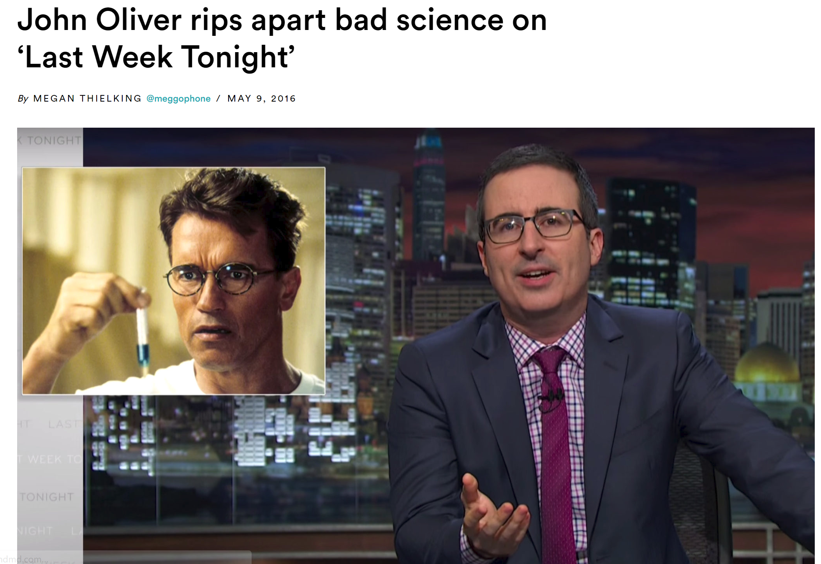
Oddball statistics?
https://www.statnews.com/2016/05/09/john-oliver-bad-science/
Warning: some inappropriate language

Slide 19
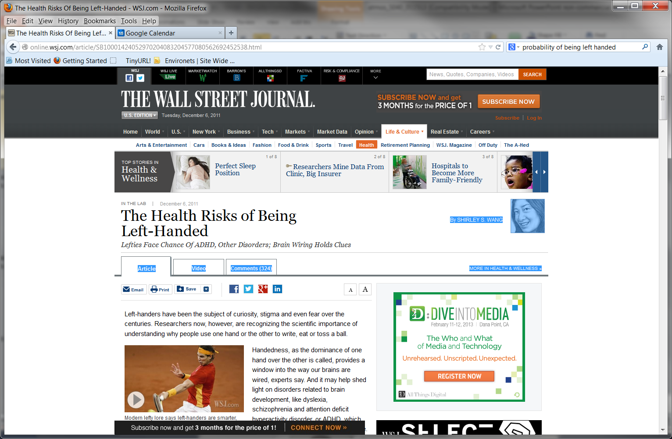
http://www.wsj.com/articles/SB10001424052970204083204577080562692452538
Modern lefty lore says left-handers are smarter, more creative and have an advantage over righties.
About 10% of people are left-handed, Six of the last 12 U.S. presidents, including Barack Obama and George H. W. Bush, have been lefties.
Babies born to older mothers or at a lower birth weight are more likely to be lefties
On average there is no difference in intelligence between right-and left-handed people.
Left-handed people earn on average 10% lower salaries than righties
lefties aren't more accident prone than right-handed people yet don't tend to die at a younger age.
Left-handedness appears to be associated with a greater risk for a number of psychiatric and developmental disorders.
About 20% of people with schizophrenia are lefties even tho 10% of people are lefties
1% of general population has schizophrenia

Slide 20
Scientific Explanations are:
based on empirical observations or experiments
tentative
historical
probabilistic
assume cause-effect relationships
limited
made public
influenced by individuals and culture

Slide 21
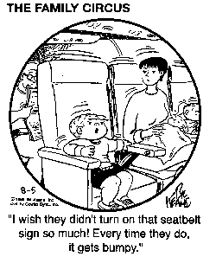
What’s the Goal??
Exploratory or descriptive statistics:
Organize and interpret volumes of data
Inferential statistics:
Assess the underlying physical processes that generate environmental data

Slide 22
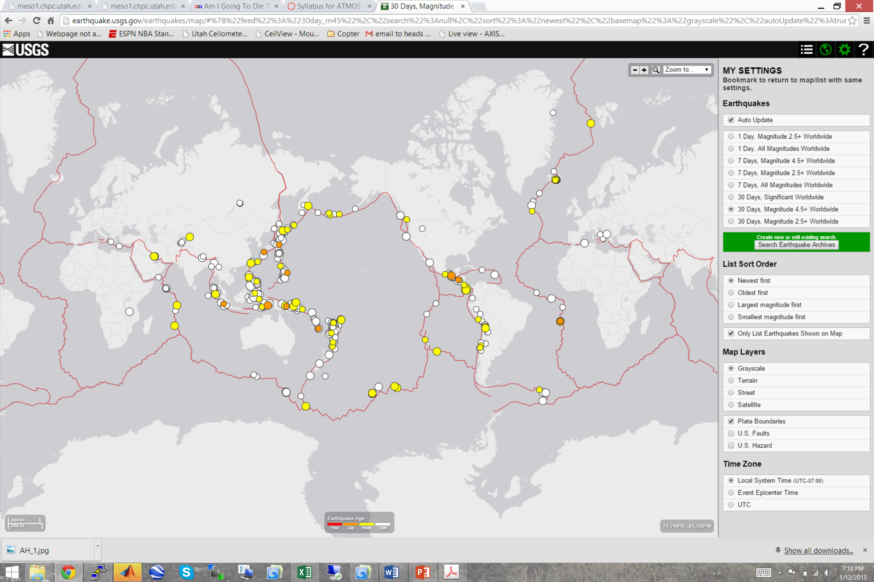
http://earthquake.usgs.gov/earthquakes/map/

Slide 23
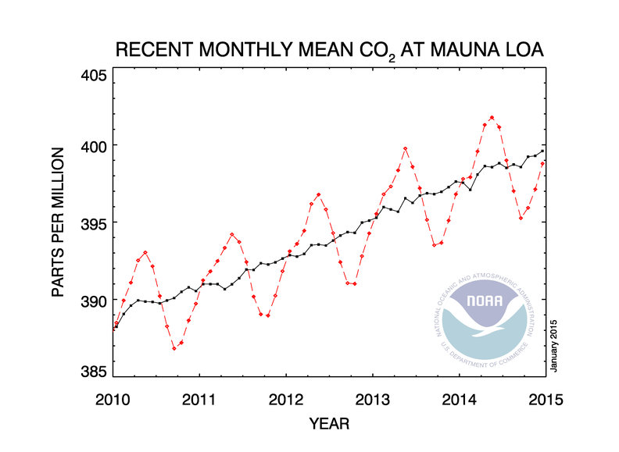
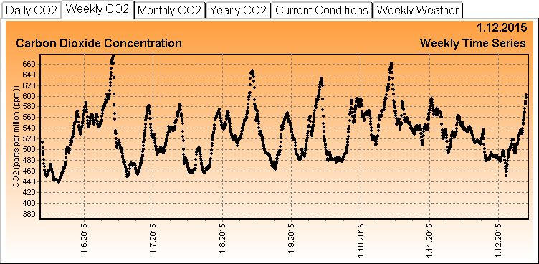
CO₂
Campus
co2.utah.edu

Slide 24

Observations and Truth
True value- value of a quantity sought through measurement, but unknown usually in the field
Truth depends on application
Assumption: average of many unbiased observations should be same as expected value of truth
However, accurate observations may be biased or unrepresentative due to siting or other factors

Slide 25
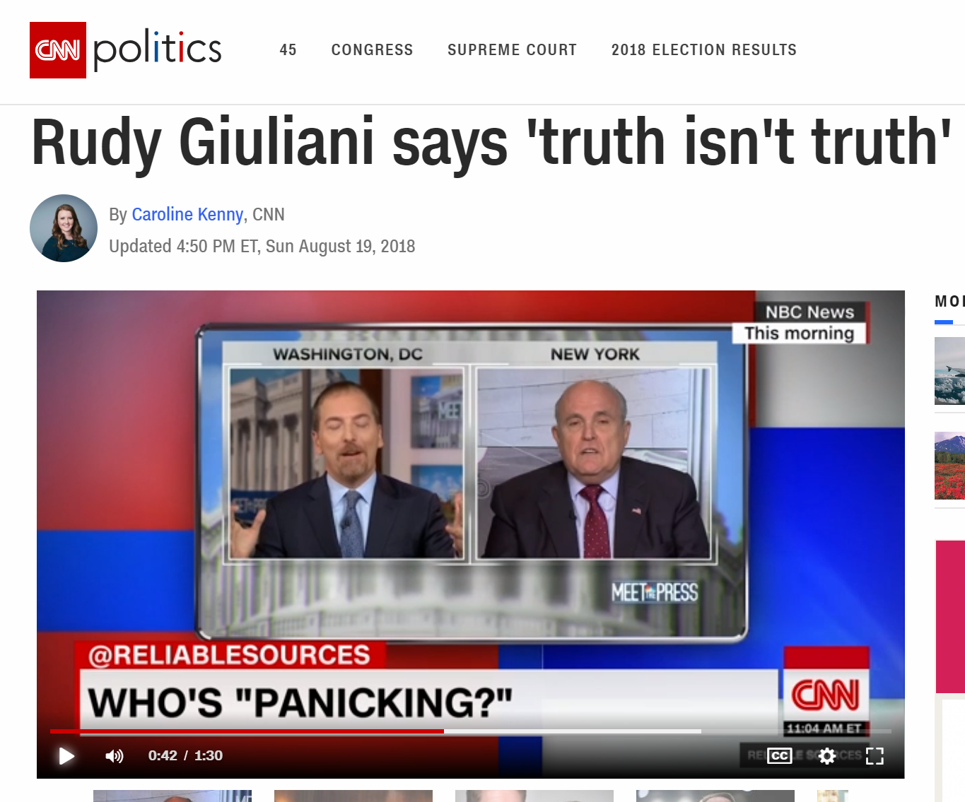

Slide 26
Causes of Uncertainty
1. we can never measure the environment with complete accuracy and precision
2. the environment is a chaotic system, which is a maddening combination of randomness and order arising from the characteristics of a complex nonlinear system,
3. our understanding of the environmental system is imperfect, so physical (and certainly statistical) models do not capture the complete behavior of the system.

Slide 27
Gauging Uncertainty
Accuracy- difference in response between a standard and instrument in varying environmental conditions a measure of how close a measurement is to the “true” value
Precision- how well repeated measurements of some quantity agree with each other. A precise instrument can be inaccurate
X
X
X
X

Slide 28
Systematic vs. Random Errors
Random- that which is not precisely predictable or determinable
Systematic- errors arising from a consistent response of a measuring device to environmental conditions or faulty characteristics of instrumentation that occurs frequently

Slide 29
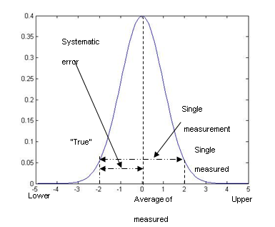
Truth vs. single and large sample of observations

Slide 30
Population vs. Sample
we never know the entire population of true values as the environmental conditions change in time or space.
We hope that we choose a sample of observations for analysis such that each element in the population has an equal chance to be selected.
Sampling issues
Trends
serial dependence of environmental data
model sample tend to be less variable than observed samples

Slide 31
Selecting a Sample
Selecting the sample for analysis is a critical aspect of organizing the data and depends on the question to be addressed by the study
rule of thumb: sample should be large enough to capture the phenomenon of interest many times
“Degrees of freedom”: number of independent elements in the sample;
usually much smaller than the total number of members in the sample in environmental data sets
Keeping your powder dry- saving data for an independent sample to evaluate and confirm your results.
Tendency to assume sample is drawn randomly from the population, when sample grossly underestimates the variability inherent in the population

Slide 32
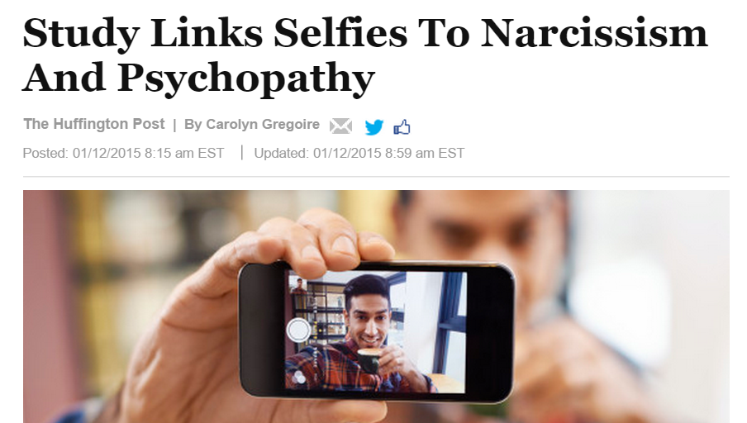
Selfies
“It’s not surprising that men who post a lot of selfies and spend more time editing them are more narcissistic, but this is the first time it has actually been confirmed in a study,”
The sample included 800 men from age 18 to 40 who completed an online survey asking about their photo posting behavior on social media. The participants also completed standard questionnaires for anti-social behaviors and for self-objectification. (This study doesn’t include women because the dataset, which Fox received from a magazine, did not have comparable data for women.):

Slide 33
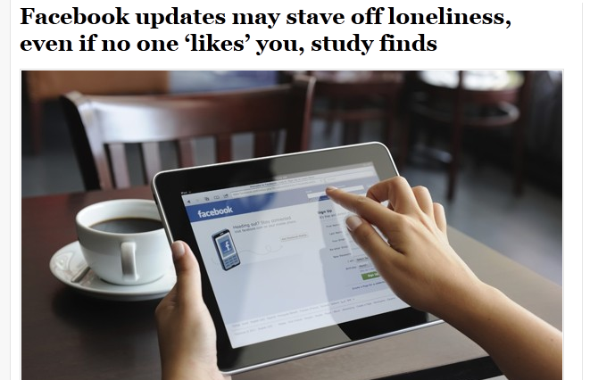
Scientists have found clues to what compels people to constantly update their Facebook status. College students who posted more status updates than they normally did felt less lonely over course of a week, even if no one “liked” or commented on their posts
researchers at Free University Berlin recruited 100 undergraduates at University of Arizona; paper published last month in Social Psychological and Personality Science.
Participants filled out surveys to measure their levels of loneliness, happiness and depression, and gave researchers access to their Facebook
students were sent an analysis of their average weekly status updates; some were told to post more updates than usual over next seven days. During that week, all completed a short online questionnaire at the end of each day about their mood and level of social connection.
Compared with other students, those who had been urged to go on a status-writing blitz felt less lonely
happiness and depression levels unchanged, “suggesting that the effect is specific to experienced loneliness,” Simply thinking about their friends can have a “social snacking” effect.
“Similar to snack temporarily reducing hunger until next meal, social snacking may help tolerate lack of ‘real’ social interaction for a certain amount of time”

Slide 34
Observations
Observations are not perfect…
Gross errors
Local siting errors
Instrument errors
Representativeness errors

Slide 35
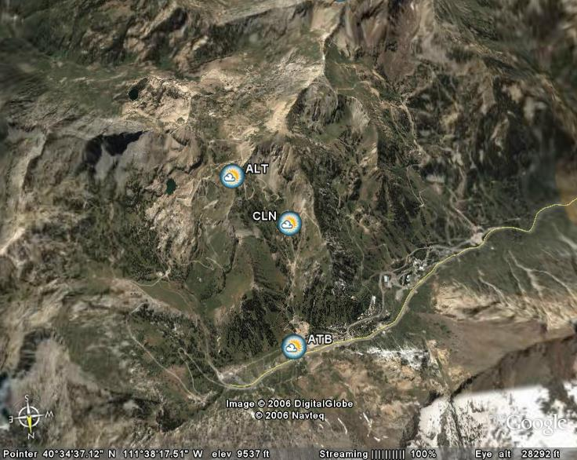
Representative errors to be expected in mountains Alta Ski Area
~5 km
~2.5 km
~2.5 km
~5 km

Slide 36
Common Goal is to Synthesize and Reduce Dimensionality
Statistical analysis of environmental data typically involves reducing the dimensionality of the data to a manageable size.
Which variable(s) do we need to consider?
Can we consider one variable (univariate analysis) or must we consider multiple variables (multivariate analysis)?
What time scales are we interested in? Hours, days, months, years? And, what region (local, regional, globally) or level in the vertical (surface, subsurface, upper air)?
Are the data available on a spatial grid or at specific points?

Slide 37
Large Dimensionality of Geophysical Data Sets
z
y
Space: x, y, z
x
t
t+1
Time: time (t) and forecast time (t_{f})
Parameter & Source (temperature, winds, different models, measuring systems, perturbations)
t
t+1

Slide 38
Climate
Statistics often misinterpreted as bookkeeping.
What is the warmest temperature on record at Salt Lake City?
What is the biggest snow storm at Alta?
weather and climate:
weather- state of the environment
climate- aggregate summary of the environment
Climate normal: arbitrarily defined reference state: 1981-2010

Slide 39
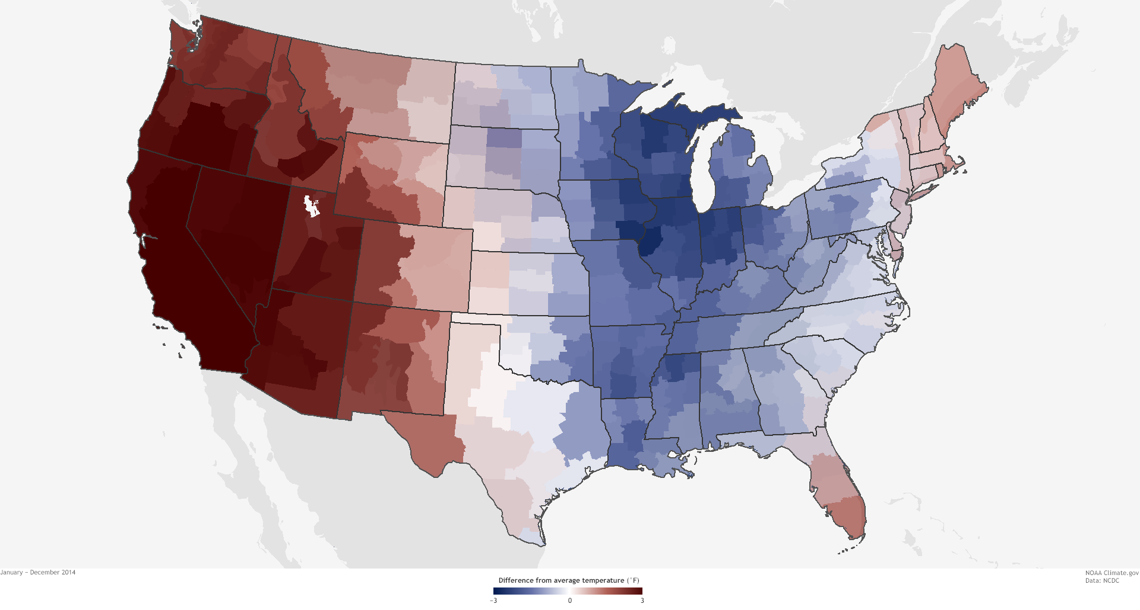
Climate.gov: 2014 temperature relative to climate normal

Slide 40
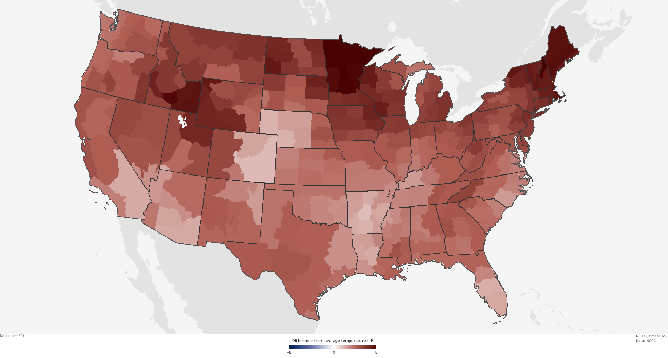
December 2014 temperature anomaly

Slide 41
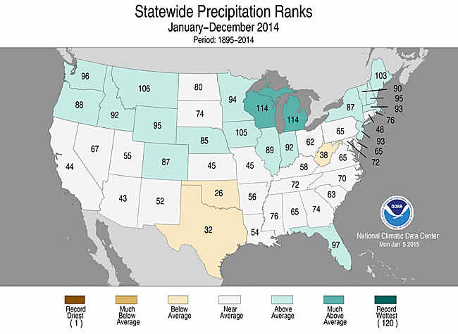
Comparing 2014 to 1895-2013

Slide 42
Why use statistics to describe the environment?
Environment controlled by innumerable factors, which we hope to segregate into a few critical factors from the rest that, for the most part, simply contribute to background noise
the characteristics of the system include linearly unstable processes such as baroclinic waves that cause growth of small features into larger ones
the characteristics of the system (dynamics, thermodynamics) are nonlinear and include discrete step functions (i.e., rain/no rain) that can lead to the amplification of small errors into large ones
the system is dissipative, which guarantees “stationarity”, i.e., the climate system will remain stable and not run away from the current state

Slide 43
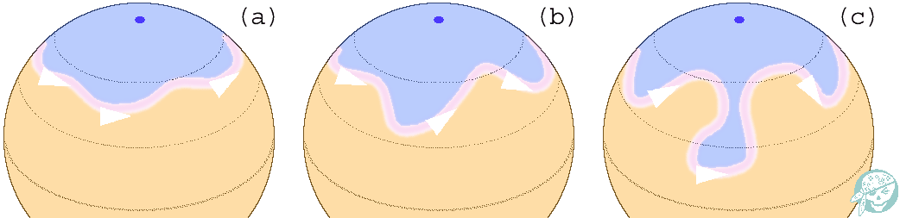
Baroclininc Wave Growth
Physical processes in atmosphere can be unstable at times but environmental system overall is “stationary”

Slide 44
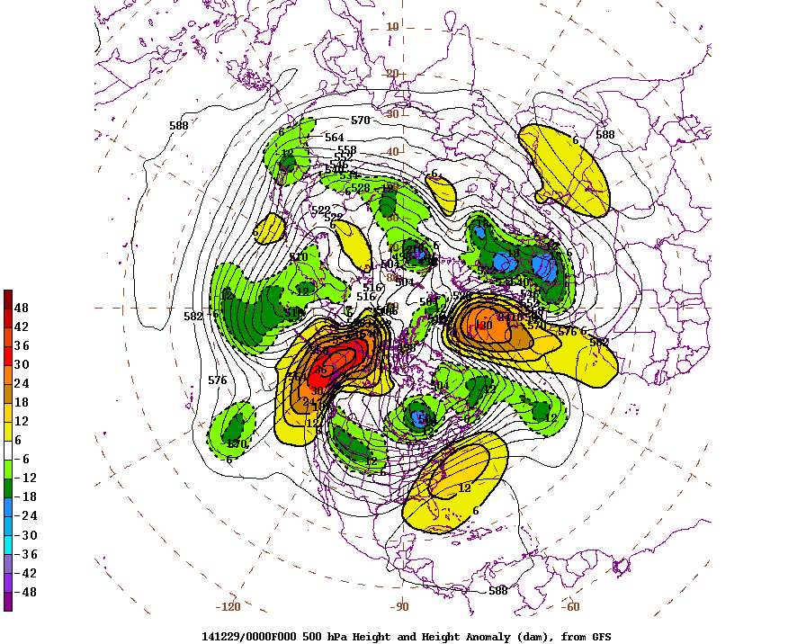

Slide 45
Steps for Effective Research
distill a general interest in a subject into a specific question/hypothesis that can be evaluated
organize the data
find relationship(s) among the data
examine the significance of your results
review thoroughly what you have done and document your analysis and results
submit your results and study for independent evaluation

Slide 46
What you should be doing
Assignment 1- Survey- Due Tonight
Read Chapter 1 Notes
Read Chapter 1 in text
No class Wednesday
Spend time reading above
Complete Assignment 2 based on Chapter 1 notes and text
Due Sunday night midnight

